Slide 1
Ali Bagheri M.D Assistant Professor in Radiation Oncology Director of Brachytherapy Services at Ahvaz Golestan Hospital Radiation Oncology Department Ahvaz Jundishapur University of Medical Sciences

Slide 4
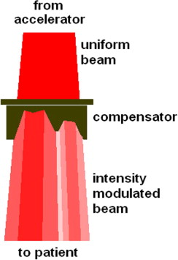
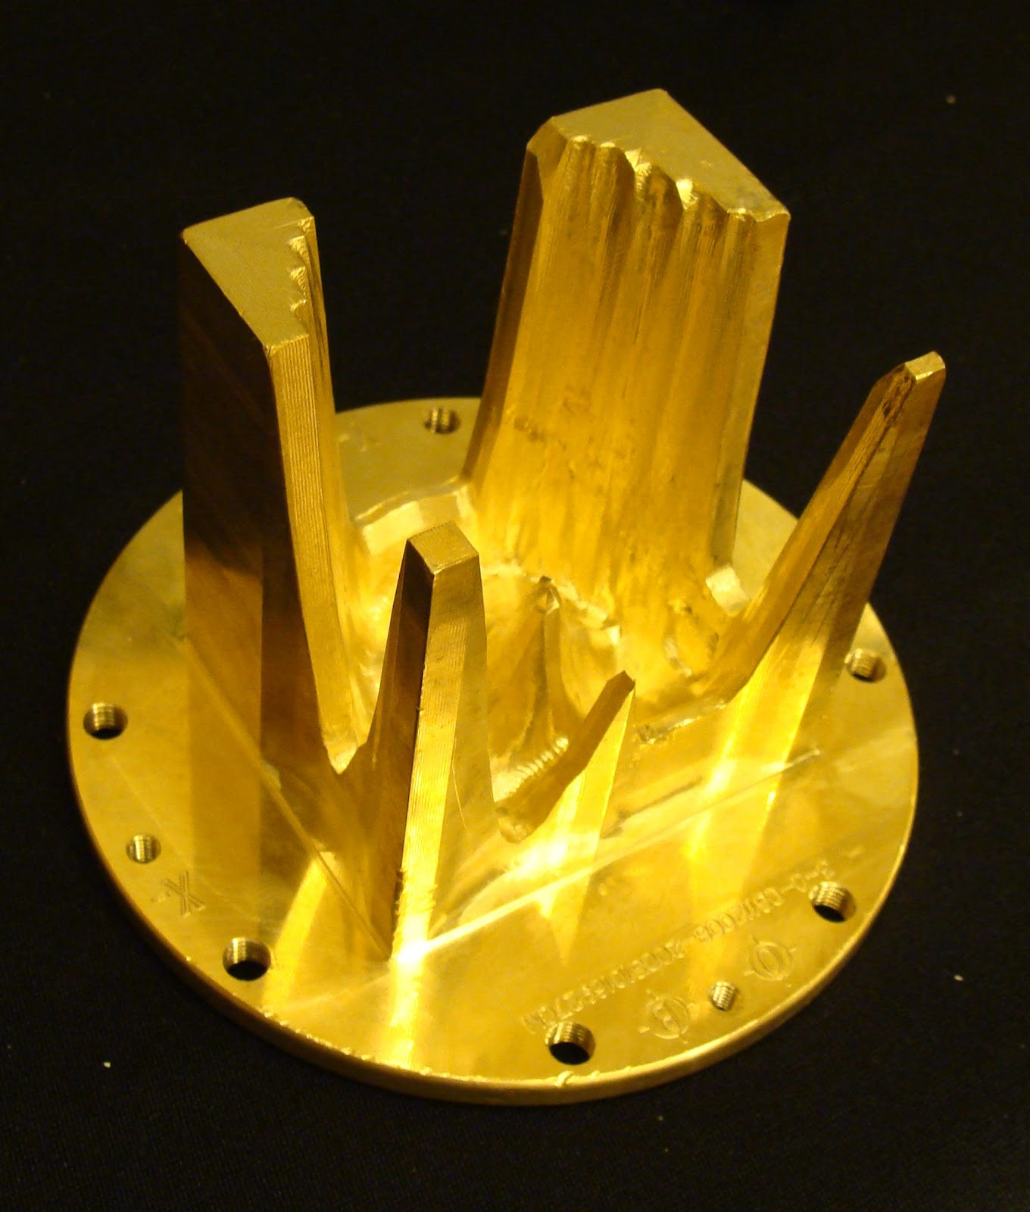
Beam Fluence Modulation in IMRT
Physical modulator

Slide 5
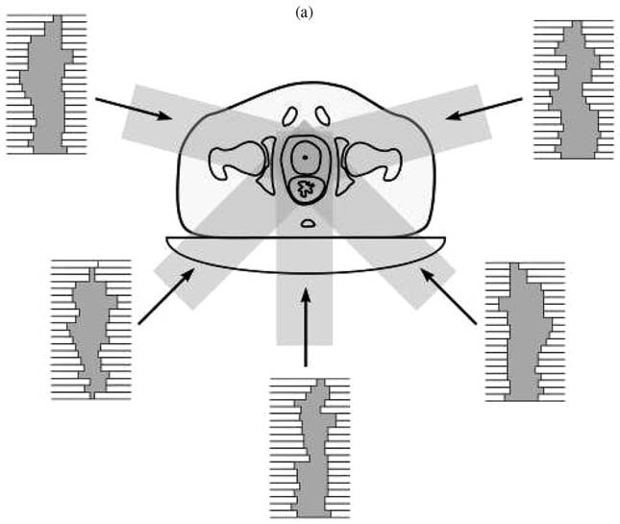
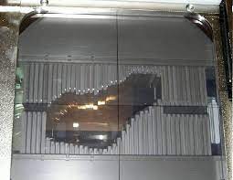
Beam Fluence Modulation in IMRT
Multileaf collimator (MLC)
Static (Step & Shoot)
Dynamic

Slide 7
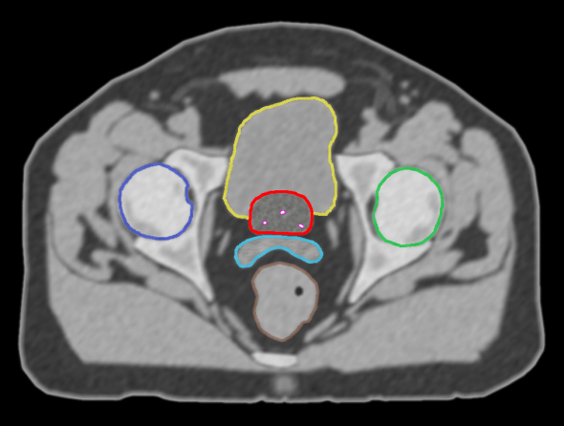
Inverse Treatment Optimization (Prostate)

Slide 8
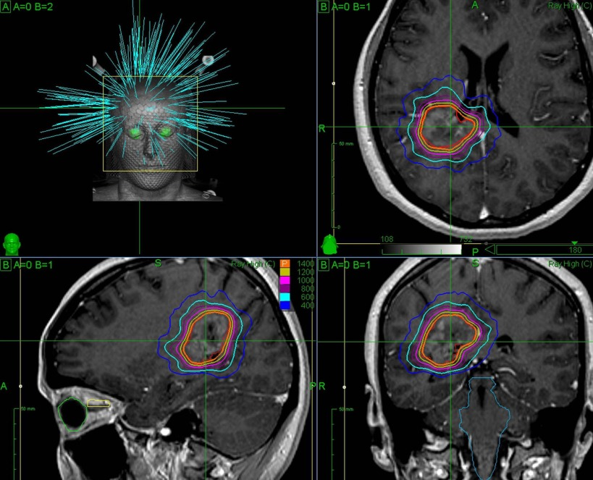
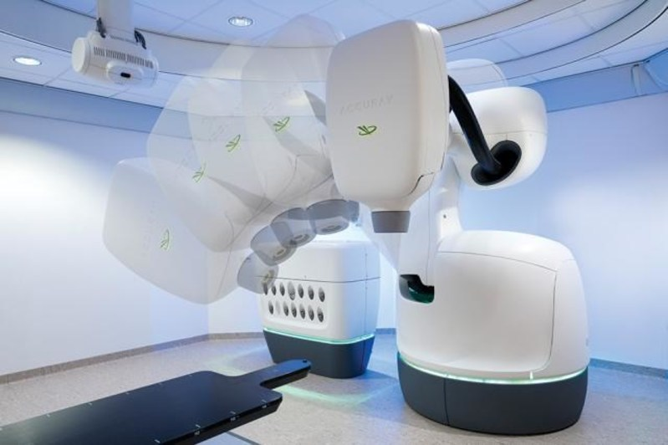
IMRT Treatment Delivery Systems
Robotic pencil beam (CyberKnife)

Slide 9
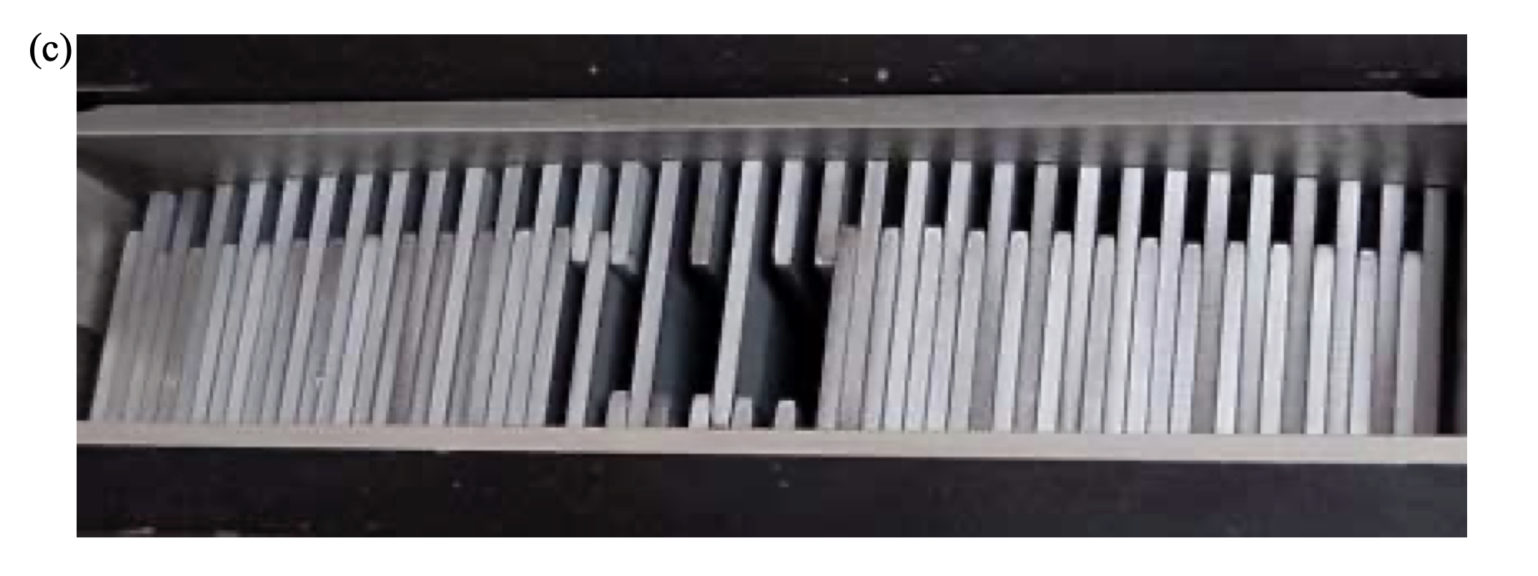
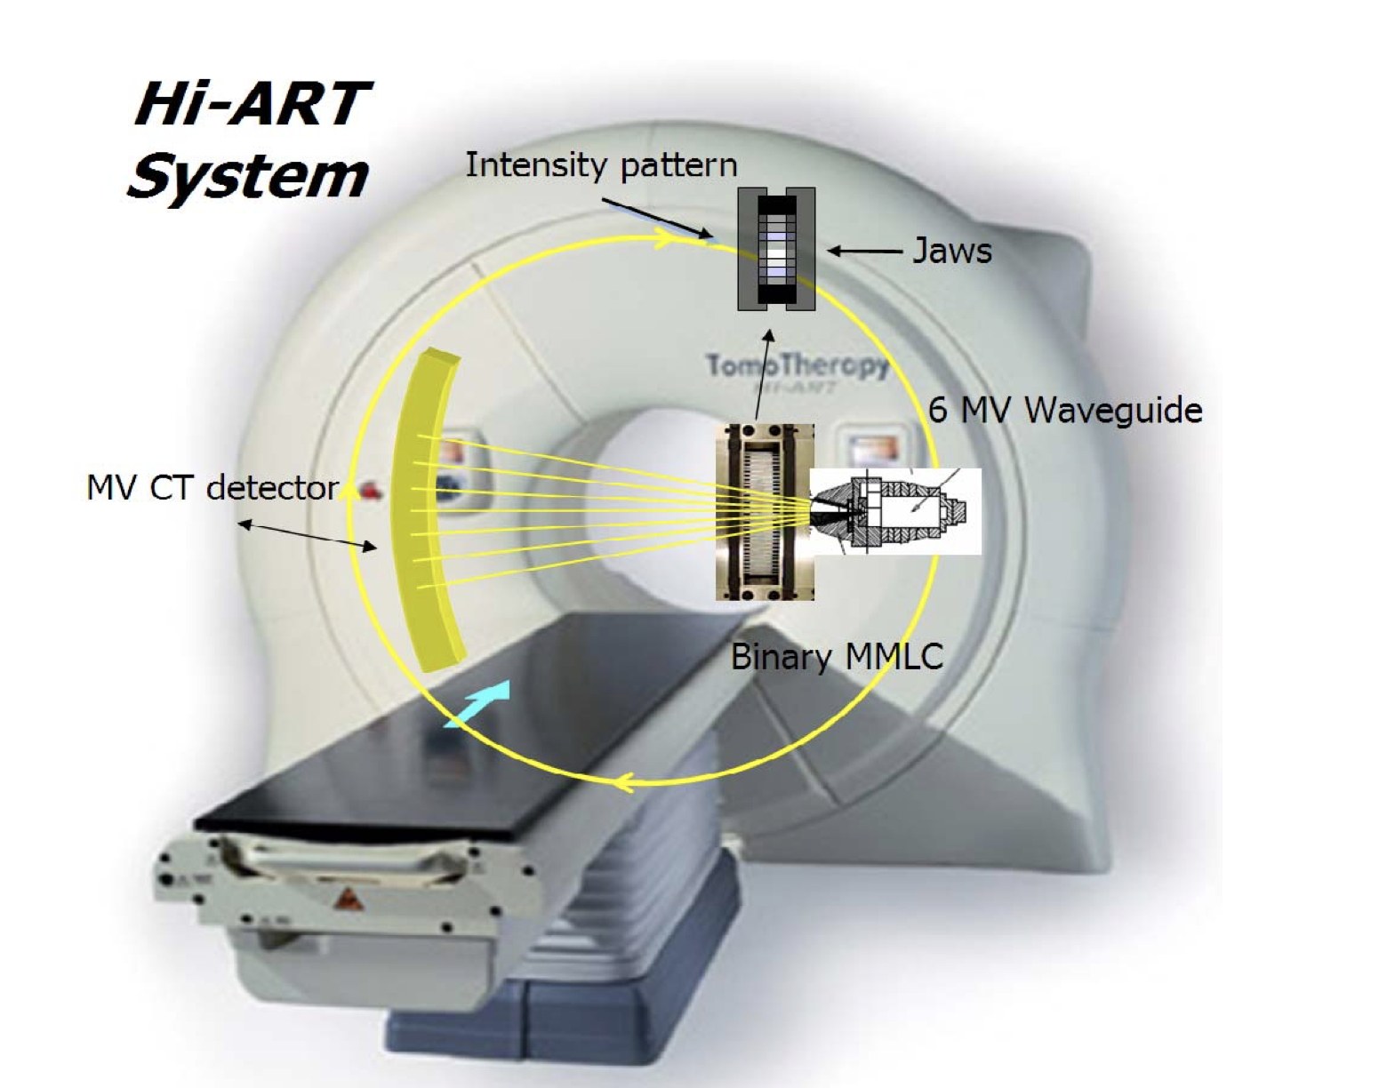
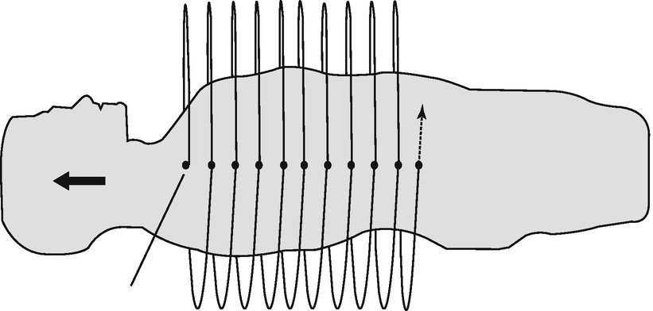
IMRT Treatment Delivery Systems
Helical tomotherapy

Slide 10
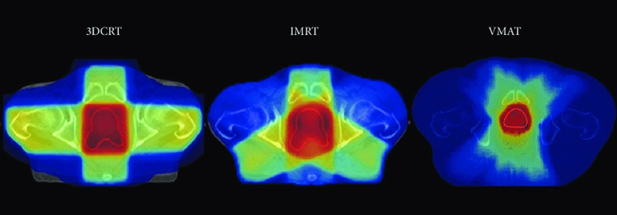
Volumetric-modulated arc therapy (VMAT)
Dynamic multileaf collimation + Arc therapy $±$ Variable dose rate

Slide 11
Patient Immobilization & Image Acquisition
Noninvasive immobilization
Volumetric CT image (Dedicated CT simulator with the patient immobilized in the treatment position) (Scan slice thickness can range from 0.5 to 2.5 mm)
Data transfer to inverse planning system.
GTV, CTV & PTV contouring
Specification of prescription pose
Treatment verification (e.g. Portal films)

Slide 12
Stereotactic Irradiation
Small volumes of 1 to 30 cm³ are treated.
Types:
Stereotactic radiosurgery (SRS) → Single fraction
Fractionated stereotactic radiosurgery or fractionated stereotactic radiation therapy (fSRS or SRT or FSRT) → More Than one fraction

Slide 13
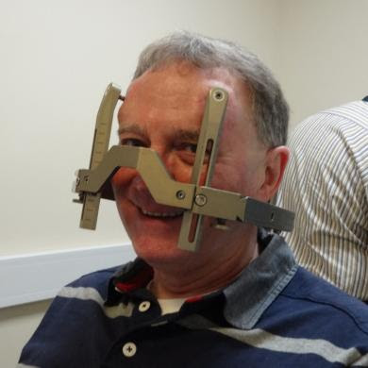
Stereotactic Irradiation (Invasive Immobilization)
Extra precision is required. (maximum error of ±1.0 mm)

Slide 14
Stereotactic Irradiation Indications
Target Size < 4cm
Arteriovenous malformations (AVMs) → 15-25 Gy
Malignant primary brain tumors
Metastatic brain tumors
Benign brain tumors (e.g. Acoustic neuroma → 18 to 25 Gy)
Functional disorders including essential tremors and obsessive-compulsive disorder

Slide 15
Gamma Knife

Slide 16
Linac-Based Stereotactic Irradiation
Conventional linac
CyberKnife
Combines a miniaturized linac mounted on an industrial robot with a system for target tracking and beam realignment to deliver the desired dose with 6 degrees of freedom.

Slide 17
Total-body Irradiation (TBI)

Slide 18
Total-body Irradiation (TBI)
Is a form of systemic therapy.
Applications
Immunosuppression:
Autoimmune diseases (Low dose)
Allogeneic bone marrow transplantation (BMT) → Dose >9.5Gy
Aplastic anemia patients prepared for BMT (3Gy)
Chronic lymphocytic leukemia (CLL) (Low dose)
Non-Hodgkin’s lymphoma (NHL) (Low dose)
Cytoreductive therapy before bone marrow or peripheral blood stem cell transplantation (High-dose)

Slide 19
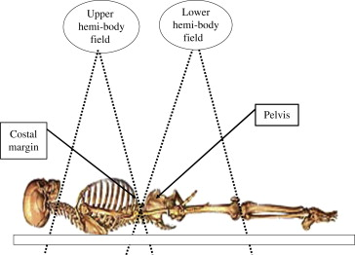
Hemi-body Irradiation (HBI)
Hemibody irradiation (HBI) was developed as a method to treat patients with disseminated tumors involving multiple sites.

Slide 20
Hemi-body Irradiation (HBI)
Single high-dose HBI is as effective as conventional fractionated irradiation in achieving pain control in patients with multiple metastases.
Dose → 6 Gy for upper HBI and 8 Gy for lower HBI
Hemibody irradiation is usually divided into upper and lower HBI.
A line passing across the bottom of L4 is commonly used to separate upper and lower HBI.

Slide 21
Image-Guided Radiotherapy (IGRT)

Slide 22
Interfraction Adjustments
These treatment alterations are concerned with changes in the target location and size, which occur on a timescale much longer than breathing motions.
Many patients are treated with combined modalities, for example, chemotherapy and RT. Hence, one can expect (and anticipate) significant movements of the tumor due to cell kill, anatomical changes in the body (e.g., weight loss), and long-term shifts in the placement of the parent organ as tumor burden is lowered.

Slide 23
IGRT
PET Scan
Ultrasound (US)
MRI
CT
KV
MV

Slide 24
Intrafraction Alternations
The most serious tumor motions on the second timescale are due to the respiratory motions of the patient.
Efforts have been made to coach patients to control breathing during irradiation, to restrict it with external restraints (and oxygen masks), but some of these are not options for patients with poor pulmonary function.
The goal is to track (or estimate) the tumor movement in real time and interactively modulate the treatment beam accordingly.

Slide 25
4D CT

Slide 26
Particle Beam Radiotherapy (Protons or Carbon ions)

Slide 27
Spread-out Bragg Peak (SOBP)

Slide 28
Indications of Particle Beam Radiotherapy
Uveal melanoma (ocular tumors)
Skull base
Paraspinal tumors (chondrosarcoma and chordoma)
Unresectable sarcomas
Pediatric neoplasms (such as medulloblastoma)

